Slide 1
INTRO TO MACHINE LEARNING
& Pandas Review

Slide 2
LESSON 3: Pandas Review & Intro to ML
LEARNING OBJECTIVES
Review experimental design and Pandas
Introduce machine learning and its role in data science
Identify machine learning questions and problems
Define the different forms of machine learning and their use cases

Slide 3
REVIEW
EXPERIMENTAL DESIGN

Slide 4
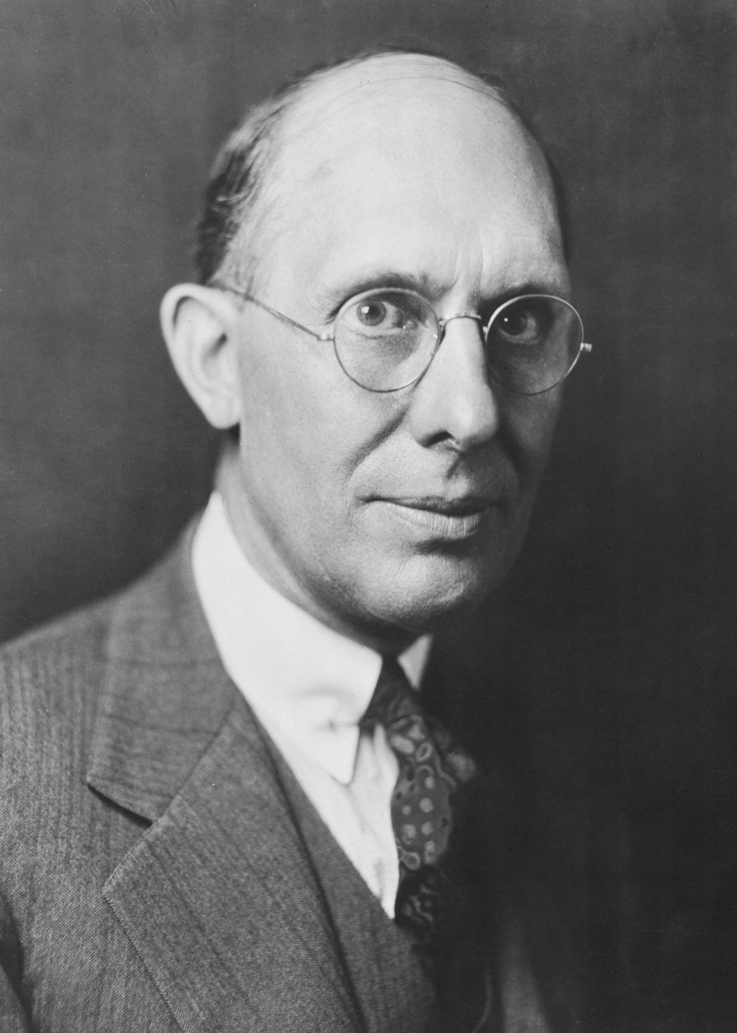
WHY DO WE NEED A GOOD QUESTION?
“A problem well stated is half solved.” -Charles Kettering
Sets yourself up for success as you begin analysis
Establishes the basis for reproducibility
Enables collaboration through clear goals

Slide 5
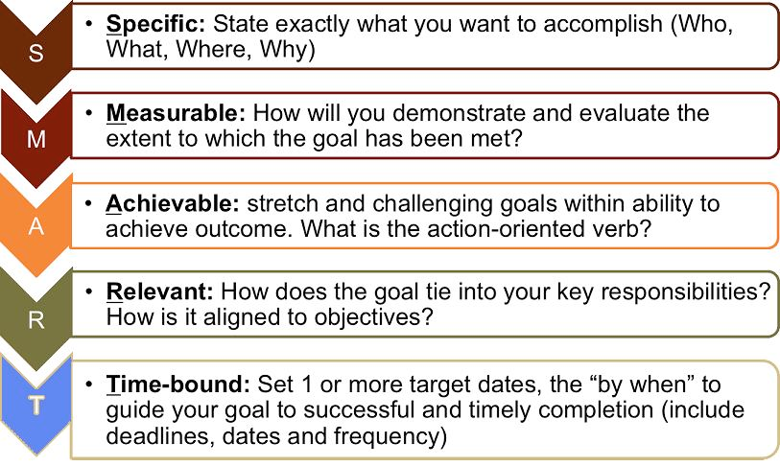
WHAT IS A GOOD QUESTION?
Goals are similar to the SMART Goals Framework.
S: specific
M: measurable
A: attainable
R: reproducible
T: time-bound

Slide 6
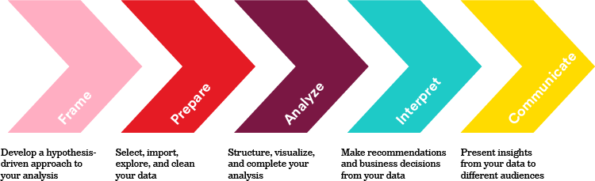
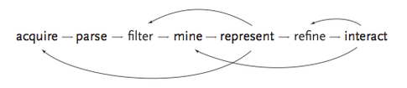
LET’S REVIEW THE DATA SCIENCE WORKFLOW
Recursion

Slide 7
DATA SCIENCE MACHINE LEARNING

Slide 8
AGENDA
I. WHAT IS MACHINE LEARNING? II. SUPERVISED LEARNING III. UNSUPERVISED LEARNING
IV. BUSINESS APPLICATION

Slide 9
INTRODUCTION
I. WHAT IS MACHINE LEARNING?

Slide 10
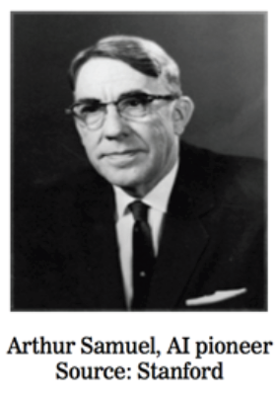
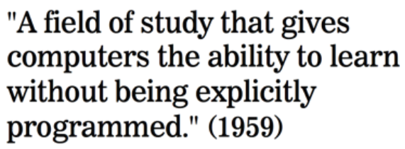
WHAT IS MACHINE LEARNING?

Slide 11
WHAT IS MACHINE LEARNING?
One definition: “Machine learning is the semi-automatic extraction of knowledge from data.”
Knowledge from data: Starts with a question that might be answerable using data
Automatic extraction: A computer provides the insight
Semi-automatic: Requires many smart decisions by a human

Slide 12
WHAT IS MACHINE LEARNING?
Machine Learning, more or less, asks the following questions:
Does X predict y? If so, by how much?
Are there any distinct groups in our data?
What are the key components of our data?
Is one of our observations “weird”?
Question: Can you think of any examples of Machine Learning?

Slide 13

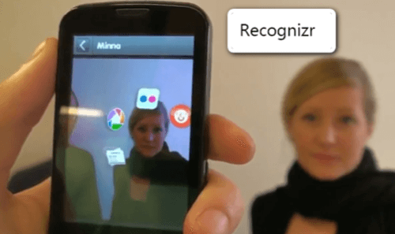

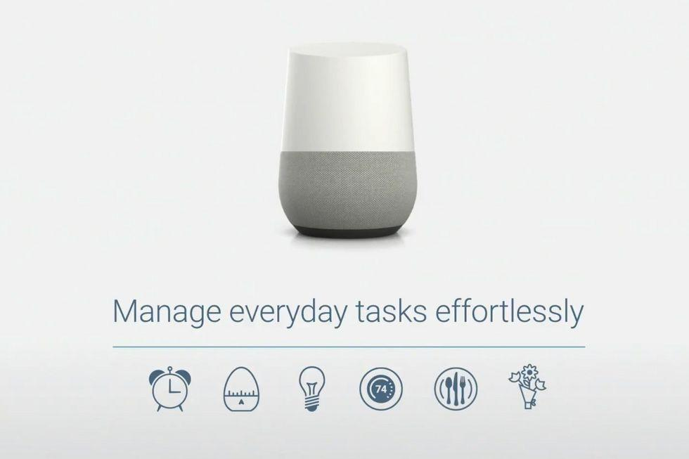


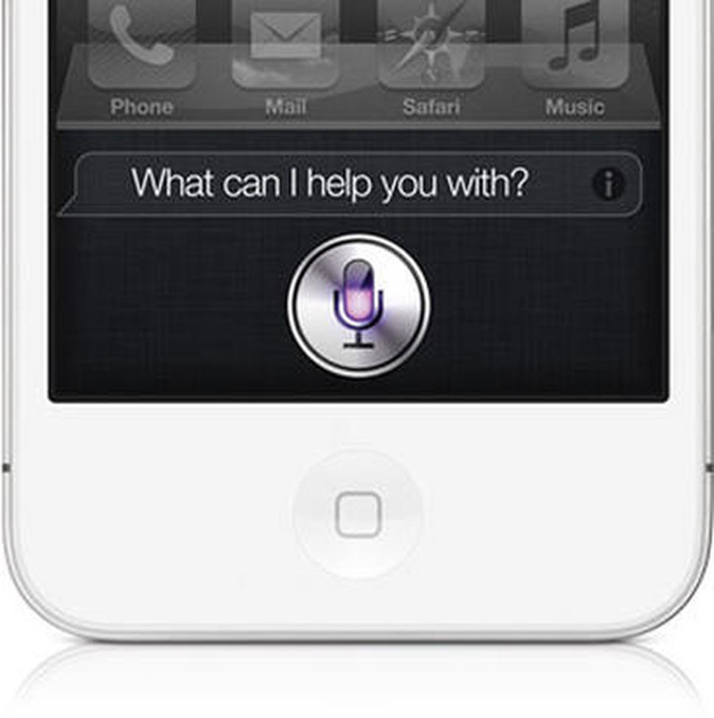
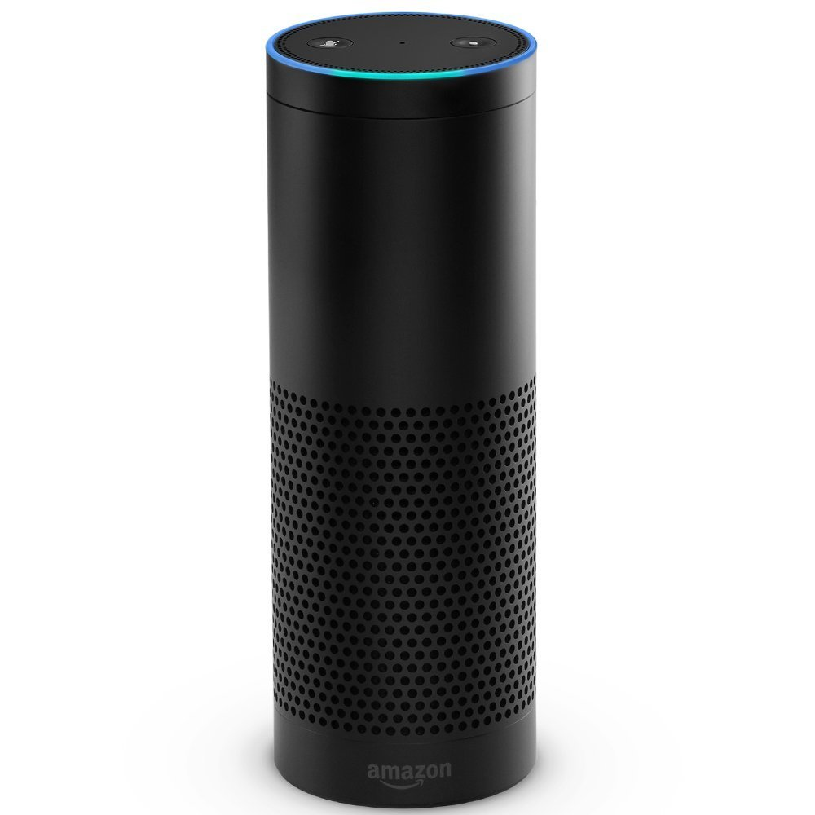

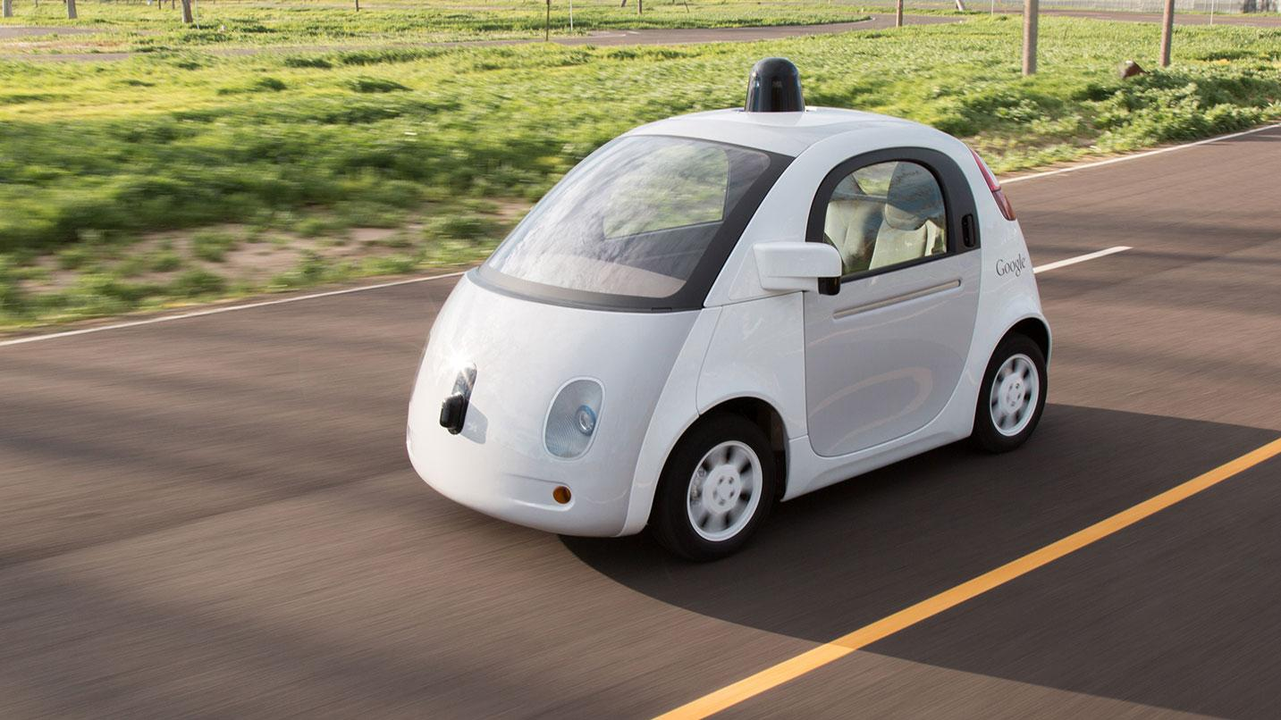
WHAT IS MACHINE LEARNING?
Successful AI Applications that use Machine Learning
Language translation services (Google)
Speech translation (Google Translate)
Song recognition (Shazam)
Face recognition (Recognizr)
Image recognition (Google Goggles)
Question answering (Google Home, Amazon Alexa, Apple Siri, IBM Watson)
Board games (IBM Deep Blue, Google DeepMind AlphaGo)
Driverless cars (Uber, Tesla, Google)

Slide 14
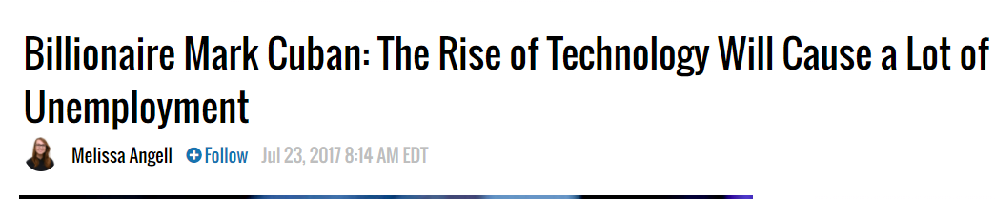
WHAT IS MACHINE LEARNING?
Will Machine Learning cause unemployment?

Slide 15
INTRODUCTION
II. SUPERVISED LEARNING

Slide 16
TYPES OF MACHINE LEARNING
There are two main categories of machine learning: supervised learning and unsupervised learning.
Supervised learning (aka “predictive modeling”):
Predict an outcome based on input data
Example: predict whether an email is spam or ham
Goal is “generalization”
Fundamental Question: does X cause Y? Can we quantify those effects?

Slide 17
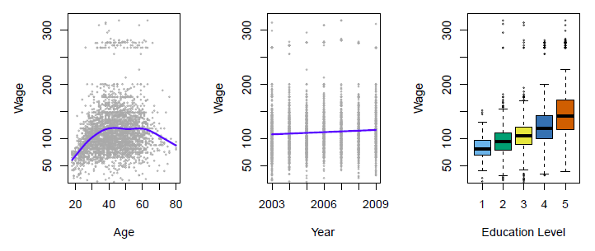
SUPERVISED LEARNING
Predict salary using demographic data
Income survey data for males from the central Atlantic region of the USA in 2009
Source: https://class.stanford.edu/c4x/HumanitiesScience/StatLearning/asset/introduction.pdf

Slide 18
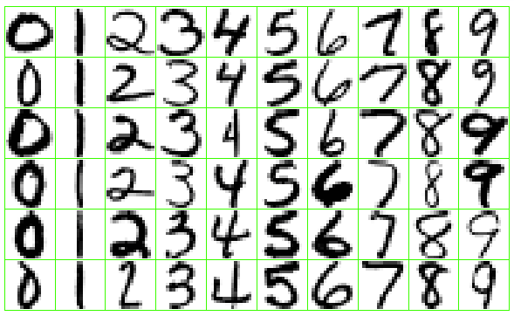
SUPERVISED LEARNING
Identify the numbers in a handwritten zip code
Source: https://class.stanford.edu/c4x/HumanitiesScience/StatLearning/asset/introduction.pdf

Slide 19
SUPERVISED LEARNING
There are two categories of supervised learning:
Regression
Outcome we are trying to predict is continuous
Examples: price, blood pressure
Classification
Outcome we are trying to predict is categorical (values in a finite set)
Examples: spam/ham, cancer class of tissue sample

Slide 20
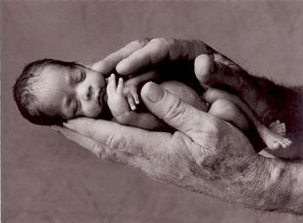
REGRESSION OR CLASSIFICATION?
Problem: Children born prematurely are at high risk of developing infections, many of which are not detected until after the baby is sick
Goal: Detect subtle patterns in the data that predicts infection before it occurs
Data: 16 vital signs such as heart rate, respiration rate, blood pressure, etc…
Impact: Model is able to predict the onset of infection 24 hours before the traditional symptoms of infection appear
Image: http://www.babycaretips4u.com/wp-content/uploads/2014/03/premature-baby.jpg
Case Study: http://www.amazon.com/Big-Data-Revolution-Transform-Think/dp/0544002695

Slide 21
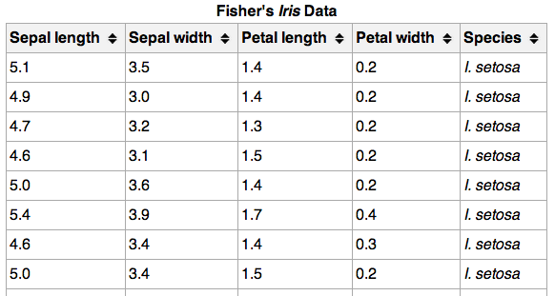
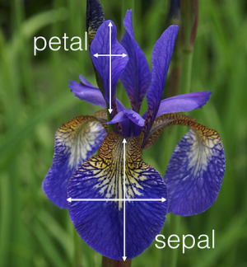
REGRESSION OR CLASSIFICATION?

Slide 22
MACHINE LEARNING TERMINOLOGY
_{150 observations}
_{(n = 150)}
{
{
Feature matrix “X” has n rows and p columns
Response “y” is a vector with length n
response
_{4 features (p = 4)}
}

Slide 23
MACHINE LEARNING TERMINOLOGY
Observations are also known as: samples, examples, instances, records
Features are also known as: predictors, independent variables, inputs, regressors, covariates, attributes
Response is also known as: outcome, label, target, dependent variable
Regression problems have a continuous response. Classification problems have a categorical response. The type of supervised learning problem has nothing to do with the features!

Slide 24
SUPERVISED LEARNING
How does supervised learning “work”?
Train a machine learning model using labeled data
“Labeled data” is data with a response variable
“Machine learning model” learns the relationship between the features and the response
Make predictions on new data for which the response is unknown
The primary goal of supervised learning is to build a model that “generalizes”: It accurately predicts the future rather than the past!

Slide 25
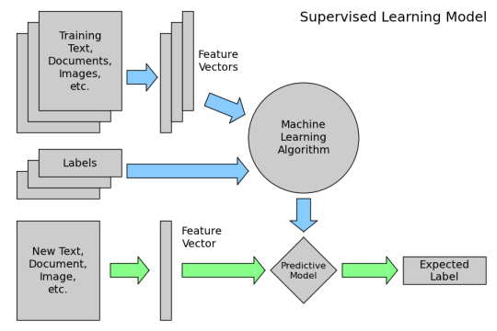
SUPERVISED LEARNING
How does supervised learning “work”?
Training Data
Test Data

Slide 26
SUPERVISED LEARNING
Supervised learning example: Coin classifier
Observations: Coins
Features: Size and mass
Response: Coin type, hand-labeled
Train a machine learning model using labeled data
Model learns the relationship between the features and the coin type
Make predictions on new data for which the response is unknown
Give it a new coin, predicts the coin type automatically

Slide 27
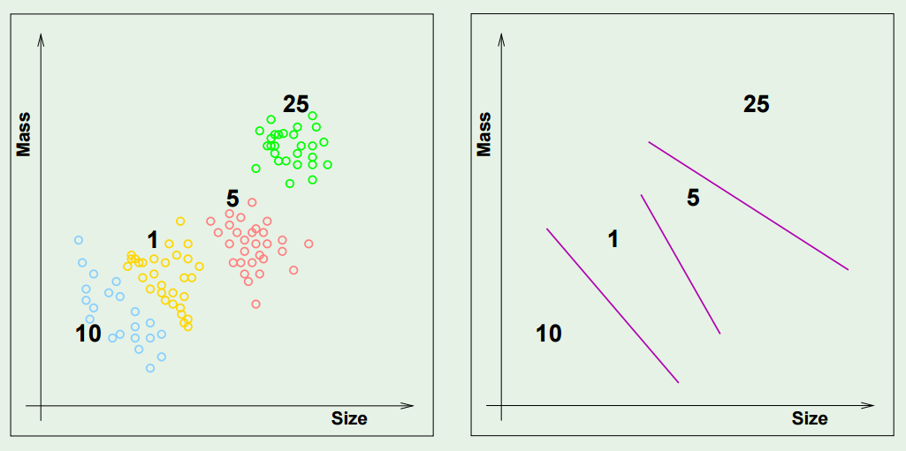
SUPERVISED LEARNING

Slide 28
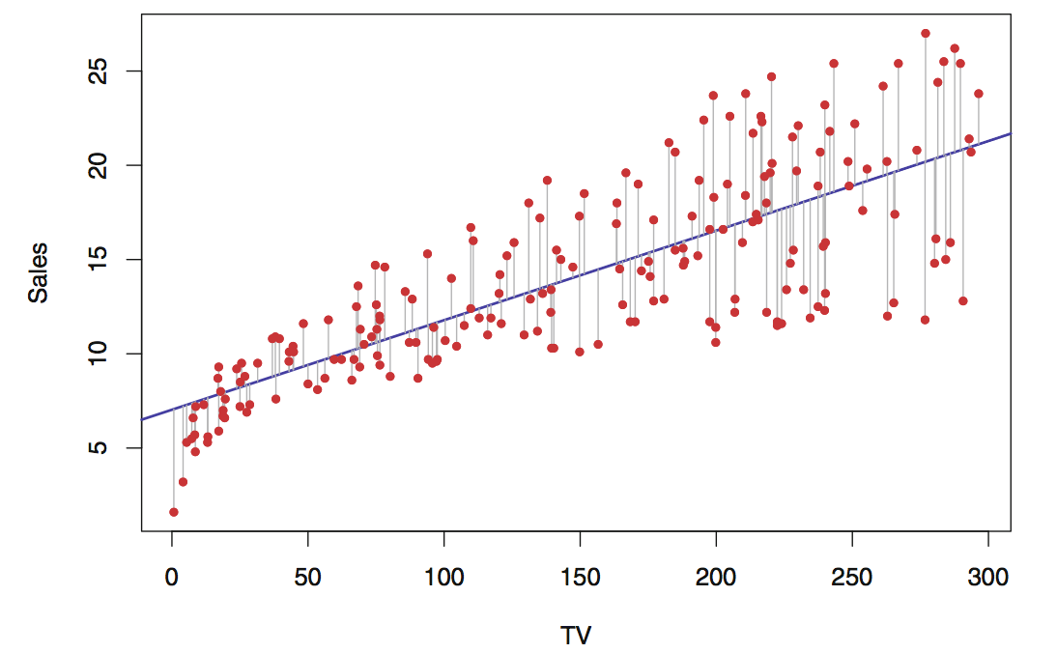
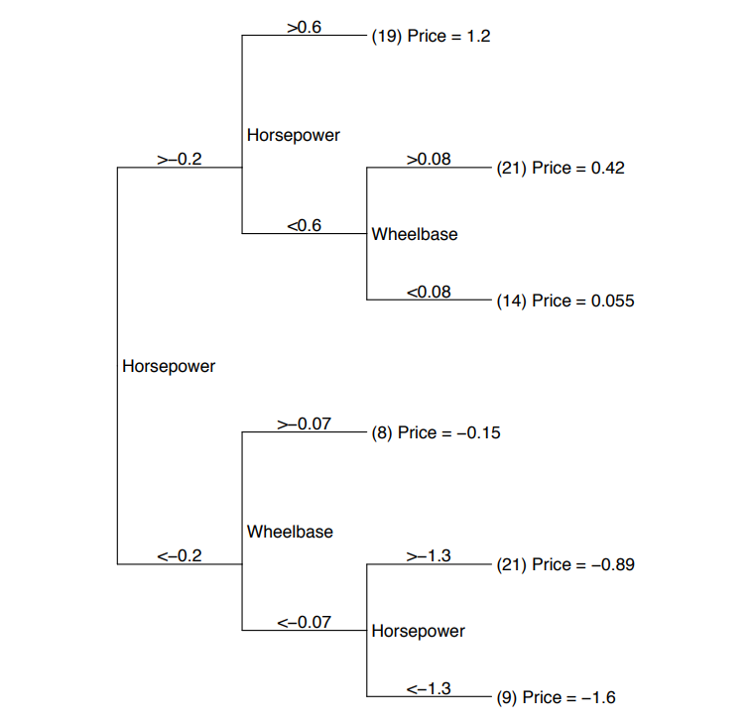
SUPERVISED LEARNING
Regression Algorithms
Linear Regression
Regression Trees
Group observations with with the highest information gain and make predictions based on the averages within group
Linear relationship between input variables and dependent variable

Slide 29

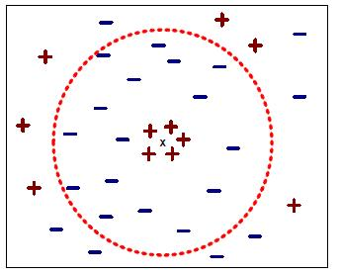
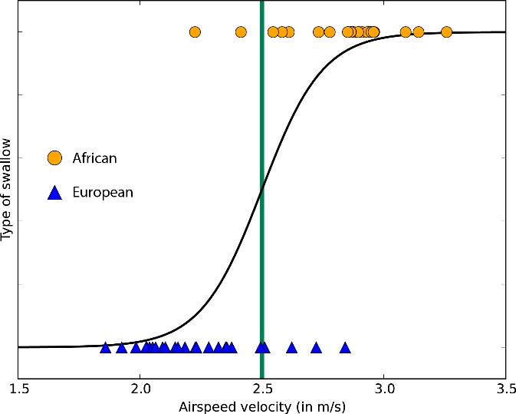
SUPERVISED LEARNING
Classification Algorithms
Logistic Regression
Decision Tree
K-Nearest Neighbors
Measures the relationship between the categorical dependent variable and one or more independent variables by estimating probabilities
Group observations with the highest information gain and make predictions based on the dominant class
Make predictions based on the “closest” neighboring observation

Slide 30
INTRODUCTION
III. UNSUPERVISED LEARNING

Slide 31
TYPES OF MACHINE LEARNING
There are two main categories of machine learning: supervised learning and unsupervised learning.
Unsupervised learning:
Extracting structure from data
Example: segment grocery store shoppers into “clusters” that exhibit similar behaviors
Goal is “representation”

Slide 32
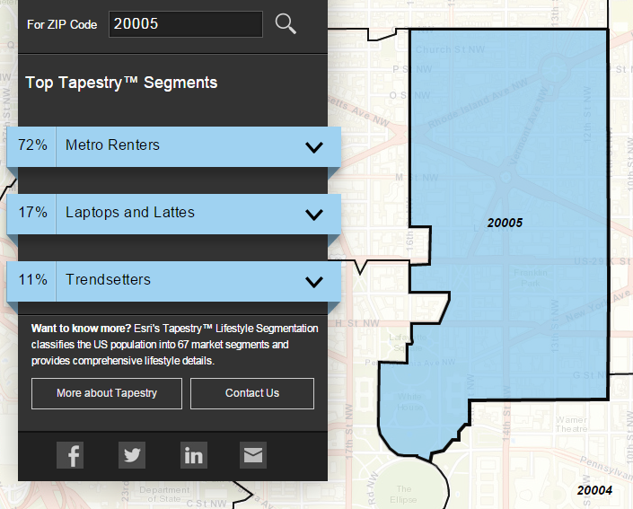
UNSUPERVISED LEARNING
Group US residential neighborhoods into 67 unique segments based on demographic and socioeconomic characteristics
Metro Renters:
Young, mobile, educated, or still in school, we live alone or with a roommate in rented apartments or condos in the center of the city. Long hours and hard work don’t deter us; we’re willing to take risks to get to the top of our professions… We buy groceries at Whole Foods and Trader Joe’s and shop for clothes at Banana Republic, Nordstrom, and Gap. We practice yoga, go skiing, and attend Pilates sessions.
Source: http://www.esri.com/landing-pages/tapestry/

Slide 33
UNSUPERVISED LEARNING
Common types of unsupervised learning:
Clustering: group “similar” data points together
Dimensionality Reduction: reduce the dimensionality of a dataset by extracting features that capture most of the variance in the data

Slide 34
UNSUPERVISED LEARNING
Unsupervised learning has some clear differences from supervised learning. With unsupervised learning:
There is no clear objective
There is no “right anwser” (hard to tell how well you are doing)
There is no response variable, just observations with features
Labeled data is not required

Slide 35
UNSUPERVISED LEARNING
Unsupervised learning example: Coin clustering
Observations: Coins
Features: Size and mass
Response: There isn’t one (no hand-labeling required!)
Perform unsupervised learning
Cluster the coins based on “similarity”
You’re done!
Sometimes, unsupervised learning is used as a “preprocessing” step for supervised learning. (How?)

Slide 36
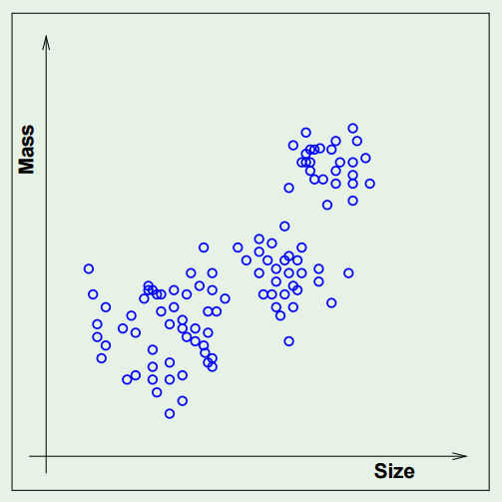
UNSUPERVISED LEARNING

Slide 37
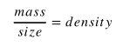
UNSUPERVISED LEARNING
Clustering
Perform unsupervised learning
Cluster the coins based on “similarity”
Inspect the grouping that the algorithm found
You’re done!
Hopefully this would put the coins into four separate groups.
Dimensionality reduction
Perform unsupervised learning
Cluster the coins based on “similarity”
Inspect the features produces by the algorithm
You’re done!
Hopefully the algorithm would recognize something like this:
Cluster 4
Cluster 1
Cluster 2
Cluster 3

Slide 38
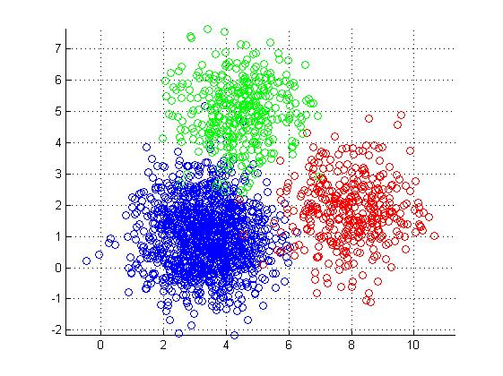
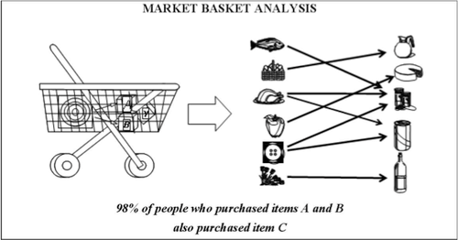
UNSUPERVISED LEARNING
K Means Clustering
Association Mining (Apriori)
Clusters data by trying to separate samples in n groups of equal variance
The Apriori algorithm can be used to determine association rules which highlight general trends in the data i.e beer is often bought alongside diapers

Slide 39
ACTIVITY (20 minutes)
DIRECTIONS
Scenario | Type of Learning (Supervised, Unsupervised, or Both) | Regression, Classification, or Both | Possible Input Variables (2-3) | Response Variable
Temperature predictions of weather
Superbowl Predictions
Characteristics of good wine
Identifying the different customer types at a Whole Foods
Finding the most commonly paired items bought at a liquor store
Detecting malignant tumors in an X-Ray
Predicting income for someone living in DC
Identifying whether an email is spam or not
**BONUS**
How Netflix suggests content (think about the different sections AKA "Top Picks", "Because you watched", "Suggestions for you")
Partner Up!
Open the “Intro to ML - Class Activity 1’ Worksheet. For each scenario, identify:
If the scenario is an example of Supervised or Unsupervised Learning,
If the scenario is an example of Regression, Classification, or both,
2-3 input variables,
The response variable

Slide 40
INTRODUCTION
IV. BUSINESS APPLICATION

Slide 41
BUSINESS APPLICATION
How can Machine Learning (ML) help address my business needs?
ML can help us answer questions like:
What is the likelihood a customer will buy this product?
Is this a good or bad review?
How much demand will there be for my service tomorrow?
Is this the cheapest way to deliver my goods?
Is there a better way to segment my marketing strategies?
What groups of products are purchased together?
Can we automate this simple yes/no decision?

Slide 42
ACTIVITY (30 minutes)
DIRECTIONS
Split into four groups and post up at a whiteboard.
Scenarios:
Mobile Clothing App - your team develops the content for a mobile clothing app and want to figure out an optimal layout such that you maximize the likelihood of a purchase.
Homeland Security - you’re part of a team that identifies illegal substances/products on ships coming into Baltimore MD.
Spotify - Your team curates playlists and help people connect with other people’s playlists.
Online Dating – Your team develops the core matching algorithm that runs the site.
Assume (1) you have access to all of the data you need and (2) Machine Learning (ML) hasn’t been implemented in any of the scenarios.
Identify: Pick one of the scenarios and think of two ways (one supervised, one unsupervised) where Machine Learning could help solve a problem.
Explain: What is the problem? How will you use ML? What will the solution look like?
Justify: How will these solutions help the business?
DELIVERABLE
Presentation of the results

